Slide 1

TECHNICAL PRESENTATION
CO1 AT 3
Dhanushya RB (192565033)
CSA0504 DATABASE MANAGEMENT SYSTEMS

Slide 2
Q1. Create and present an ER Diagram for an Online Library System, explaining each component clearly.

Slide 3
ER Diagram for an Online Library Management System
The Online Library Management System is designed to automate library operations by managing books, users, borrowing, reservations, and librarians. An Entity Relationship (ER) Diagram represents the database structure by identifying entities, their attributes, and the relationships among them.
Main Entities
👤 User
📚 Book
📖 Borrow Transaction
🔖 Reservation
👨‍💼 Librarian
Purpose
Organizes library data efficiently.
Reduces manual record keeping.
Ensures proper relationship between books and users.
Supports online issue, return, and reservation of books.

Slide 4
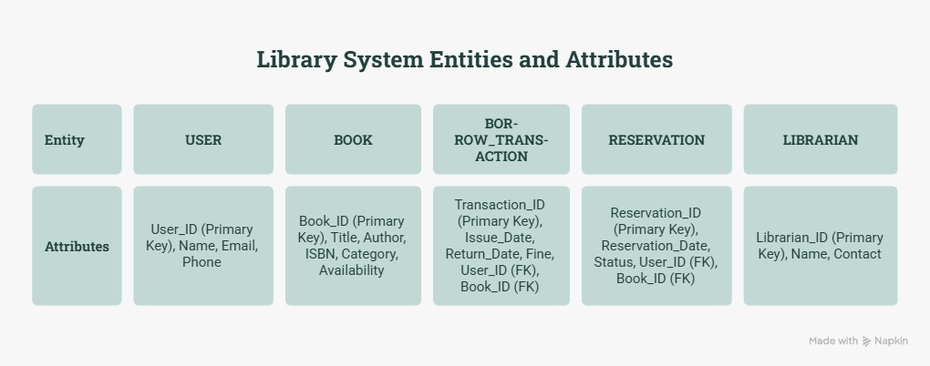
ER Diagram

Slide 5
Explanation
1. User Entity
Stores member information such as User ID, Name, Email, and Phone Number. A user can borrow and reserve multiple books.
2. Book Entity
Contains details of every book including Book ID, Title, Author, ISBN, Category, and Availability Status.
3. Borrow Transaction
Acts as a bridge between User and Book. It stores Issue Date, Return Date, and Fine details.
4. Reservation
Keeps track of books reserved by users when they are unavailable.
5. Librarian
Maintains the library database, updates book records, and manages issue/return operations.

Slide 6
Q2. Prepare a presentation on the EER Model demonstrating Generalization and Specialization with a University case study.

Slide 7
Introduction to EER Model
Definition
The Enhanced Entity Relationship (EER) Model is an advanced version of the ER model that provides additional features such as Generalization, Specialization, Inheritance, and Aggregation to represent complex real-world database structures more effectively.
Why EER?
Models complex database requirements.
Supports inheritance of attributes.
Reduces redundancy.
Improves scalability and flexibility.
Represents real-world objects accurately.
Key Concepts
Generalization
Specialization
Inheritance

Slide 8
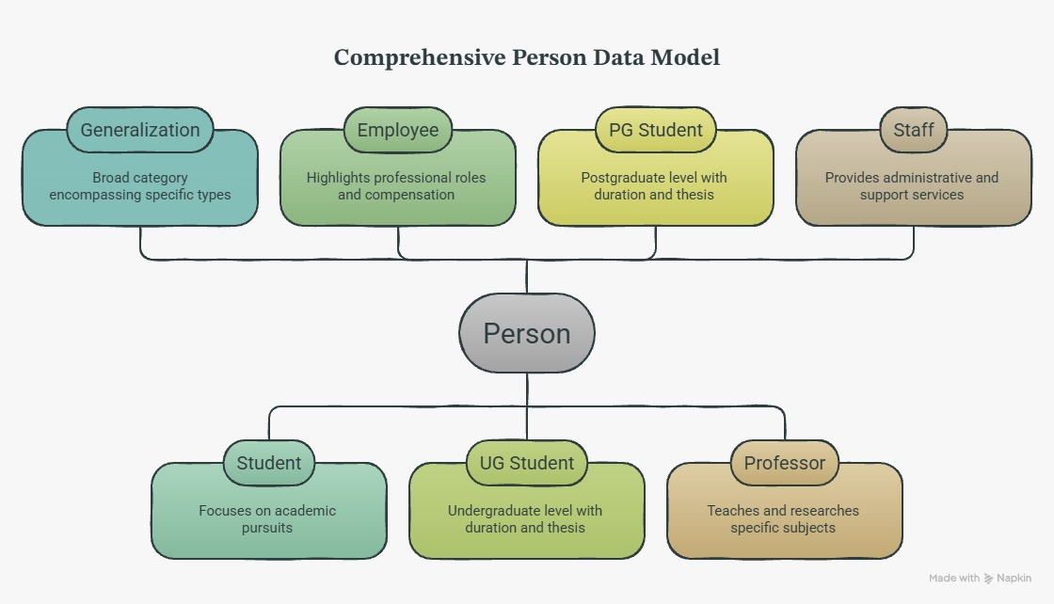

Slide 9
Benefits and Applications of EER Model
Generalization
Generalization combines multiple lower-level entities into a higher-level entity based on common attributes.
Example:
Student and Employee share common attributes such as Name, Address, and Phone.
These are generalized into a common superclass called Person.
Specialization
Specialization divides a higher-level entity into lower-level entities based on specific characteristics.
Example:
Student → UG Student, PG Student
Employee → Professor, Staff

Slide 10
Q3.Present the concept of Data Independence (Logical and Physical) and its significance in DBMS Architecture.

Slide 11
Data Independence
Data Independence is the ability of a Database Management System (DBMS) to modify the database schema at one level without affecting the schema at the next higher level. It allows changes to the database structure without requiring modifications to application programs.
Types of Data Independence
Logical Data Independence
Physical Data Independence
DBMS Three-Level Architecture
External Level: User views of the database.
Conceptual Level: Overall logical structure of the database.
Internal Level: Physical storage and organization of data.
Importance
Reduces application maintenance.
Provides flexibility in database design.
Improves system scalability.
Makes database management easier.

Slide 12
Types of Data Independence
Logical Data Independence
Modifies the conceptual schema without affecting user applications.
Supports changes in database structure.
Examples:
Add a new column.
Create a new table.
Modify relationships.
Physical Data Independence
Modifies the internal schema without affecting the logical structure.
Improves storage and performance.
Examples:
Create indexes.
Change file organization.
Upgrade storage devices.

Slide 13
Significance in DBMS Architecture
Benefits
Improves database flexibility.
Simplifies database maintenance.
Protects application programs from schema changes.
Reduces development and maintenance costs.
Enhances performance optimization.
Supports future database expansion.
Ensures efficient data management.
Applications
Banking Systems
Hospital Management Systems
Online Library Systems
E-commerce Platforms
University Management Systems

Slide 14
Q4. Deliver a technical presentation on the software components of a DBMS explaining Query Processor, Storage Manager and Transaction Manager.

Slide 15
Software Components of a DBMS
Definition
A Database Management System (DBMS) consists of software components that work together to store, retrieve, manage, and secure data efficiently.
Main Components
Query Processor
Storage Manager
Transaction Manager
Objectives
Process user queries efficiently.
Manage data storage and retrieval.
Ensure data consistency and reliability during transactions.

Slide 16
Components
1. Query Processor
Interprets SQL queries submitted by users.
Checks query syntax and validity.
Example:
SELECT * FROM Student WHERE Department = 'CSE';
2. Storage Manager
Stores and retrieves data from the database.
Manages files, indexes, and memory.
Example:
Retrieving student records stored on disk.
3. Transaction Manager
Controls database transactions.
Maintains data consistency and integrity.
Supports Commit and Rollback operations.
Handles concurrent user access.

Slide 17
Benefits of DBMS Components
Importance of DBMS Software Components
Query Processor
✔ Faster query execution
✔ Optimized SQL processing
Storage Manager
✔ Efficient storage utilization
✔ Quick data retrieval
Transaction Manager
✔ Prevents data loss
✔ Ensures ACID properties
✔ Supports multi-user access

Slide 18
Q5. Prepare a presentation comparing Strong and Weak Entities in ER Modeling with real-world examples.

Slide 19
Strong and Weak Entities in ER Modeling
Definition
An Entity is a real-world object that can be identified and stored in a database. Based on identification, entities are classified into Strong Entities and Weak Entities.
Strong Entity
Has its own Primary Key.
Can exist independently.
Easily identified by its unique key.
Weak Entity
Does not have a complete Primary Key.
Depends on a Strong Entity for identification.
Uses a Partial Key along with the Strong Entity's Primary Key.

Slide 20
Strong Entity vs Weak Entity
Strong Entity
A strong entity has its own Primary Key, allowing it to be uniquely identified.
It can exist independently without relying on any other entity.
It is represented by a single rectangle in an ER diagram.
Example: Student (Student_ID, Name, Department)
Weak Entity
A weak entity cannot be uniquely identified by its own attributes.
It depends on a Strong Entity and uses a Partial Key along with the Strong Entity's Primary Key for identification.
It is represented by a double rectangle in an ER diagram.
Example: Student Certificate (Certificate_ID, Type) – A certificate exists only if the corresponding student exists.

Slide 21
Real-World Examples & Conclusion
Example 1 – College Database
Strong Entity: Student (Student_ID, Name, Department)
Weak Entity: Student Certificate (Certificate_ID, Type)
A certificate cannot exist without a student.
Example 2 – E-Commerce
Strong Entity: Order (Order_ID, Date)
Weak Entity: Order Item (Product_ID, Quantity)
An order item exists only if an order exists.
Advantages
Reduces data redundancy.
Maintains referential integrity.
Represents real-world relationships accurately.
Improves database organization.

